Slide 1
Games to build proficiency
Reme (ask me)

Slide 2
Match the questions with the answers dominoes
Put them in order to create a cool conversation!!
What do you like to do?
How is your family like?
How old are you?
What days do you go to school?
What do you like to eat for lunch?
Do you have a pencil?
I like to swim
My family is big. I have 4 brothers.
I am 8 years old.
I go to school on Mondays, Tuesdays, Wednesdays, Thursdays, Fridays.
I like to eat hamburgers and chips.
Yes I have two pencils.
When do you like to swim?
What does your mom like to do?
When is your birthday?
What is your favorite subject?
And what do you like eat for dinner?
What do you need?
I like to swim in the summer.
My mom likes to cook and my dad likes to read.
My birthday is May 5th
I like Spanish.
I like to eat chicken and vegetables.
I need a pencil.
Notes:
The teacher needs to print them and cut the cubes out and ask the students to put them in order to create a conversation.

Slide 3
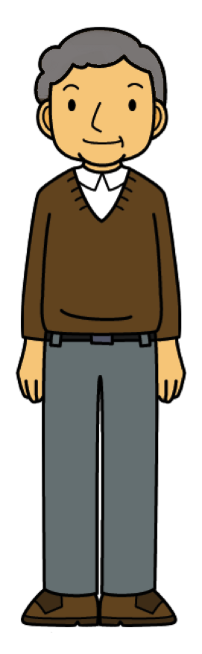
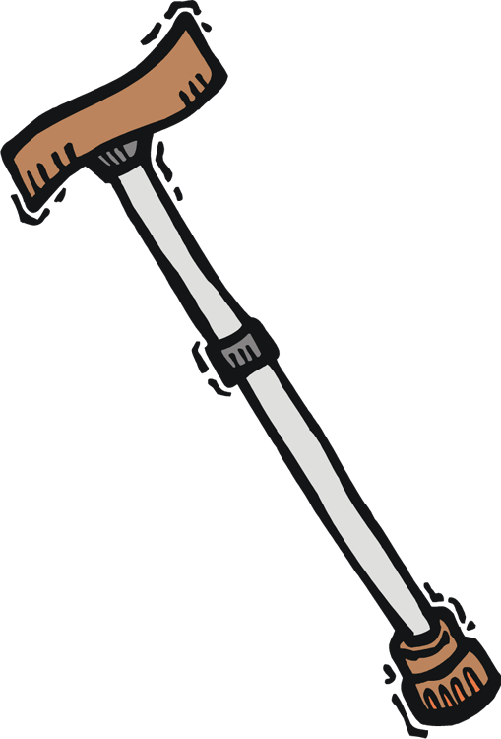
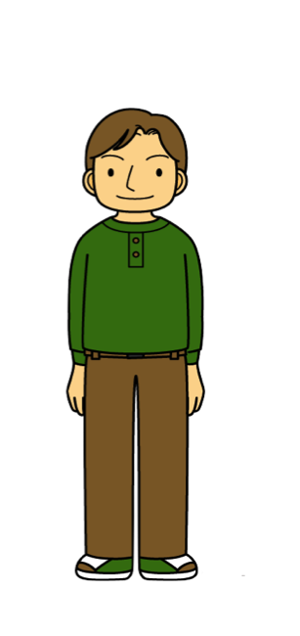
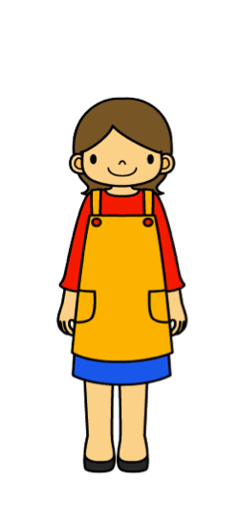
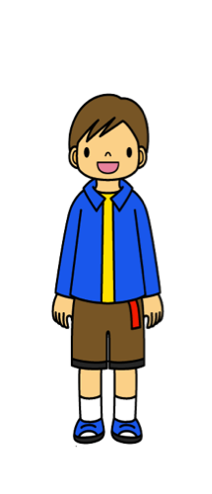
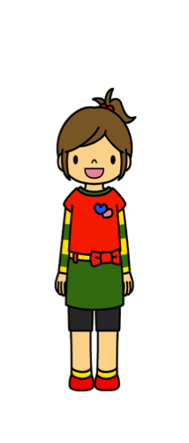
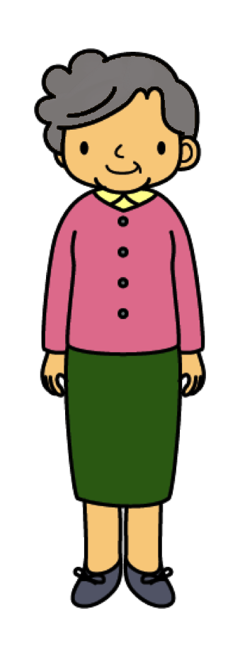




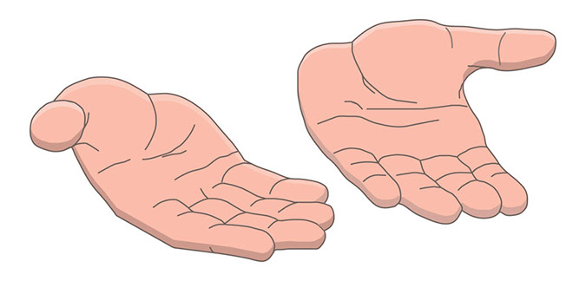
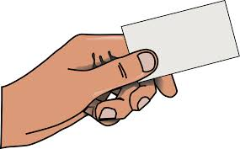
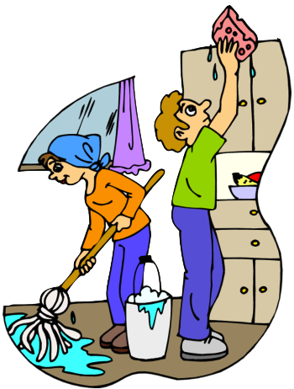
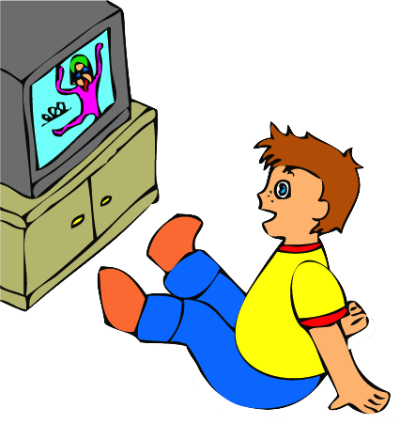
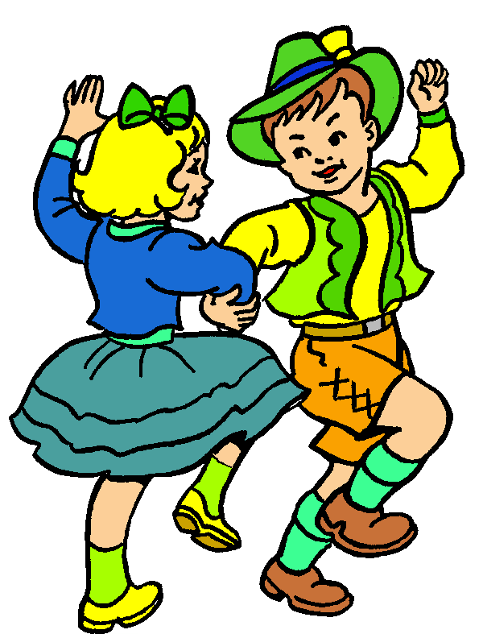
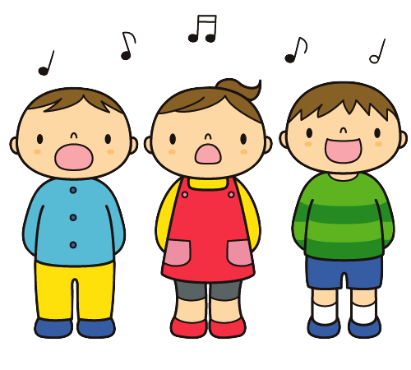

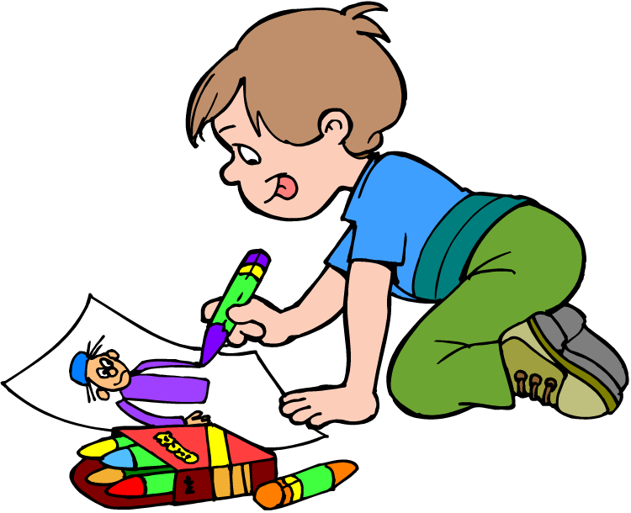
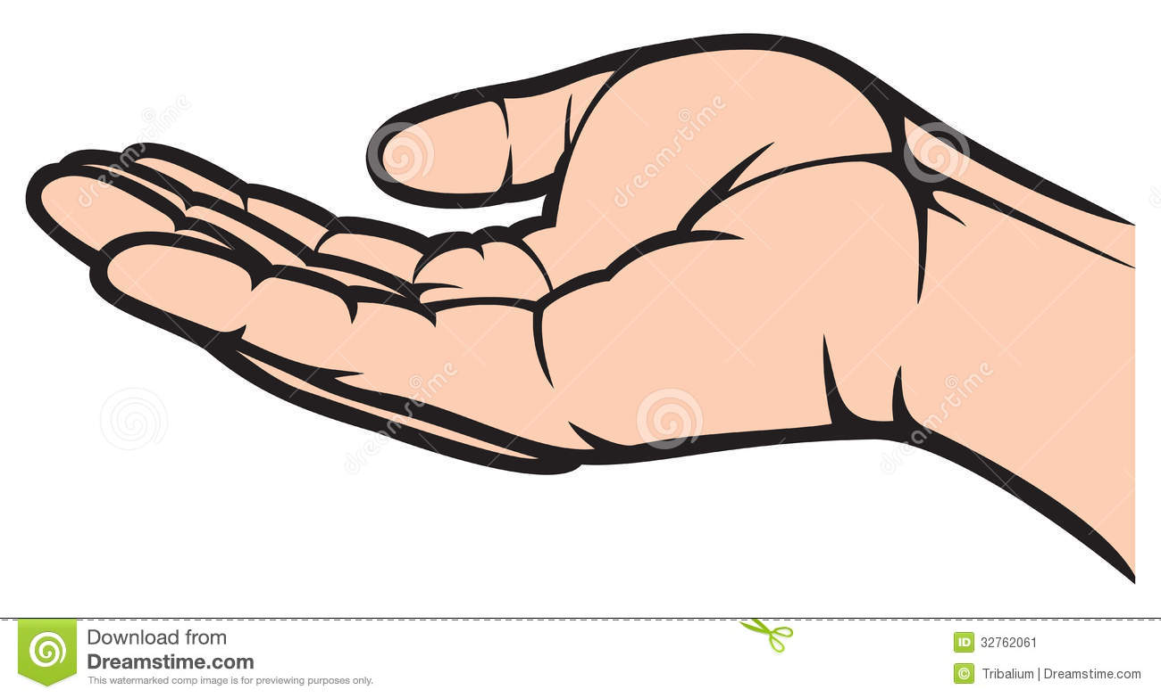

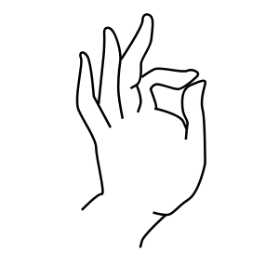
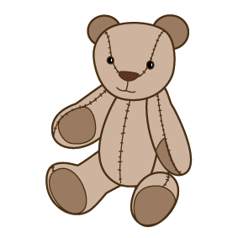
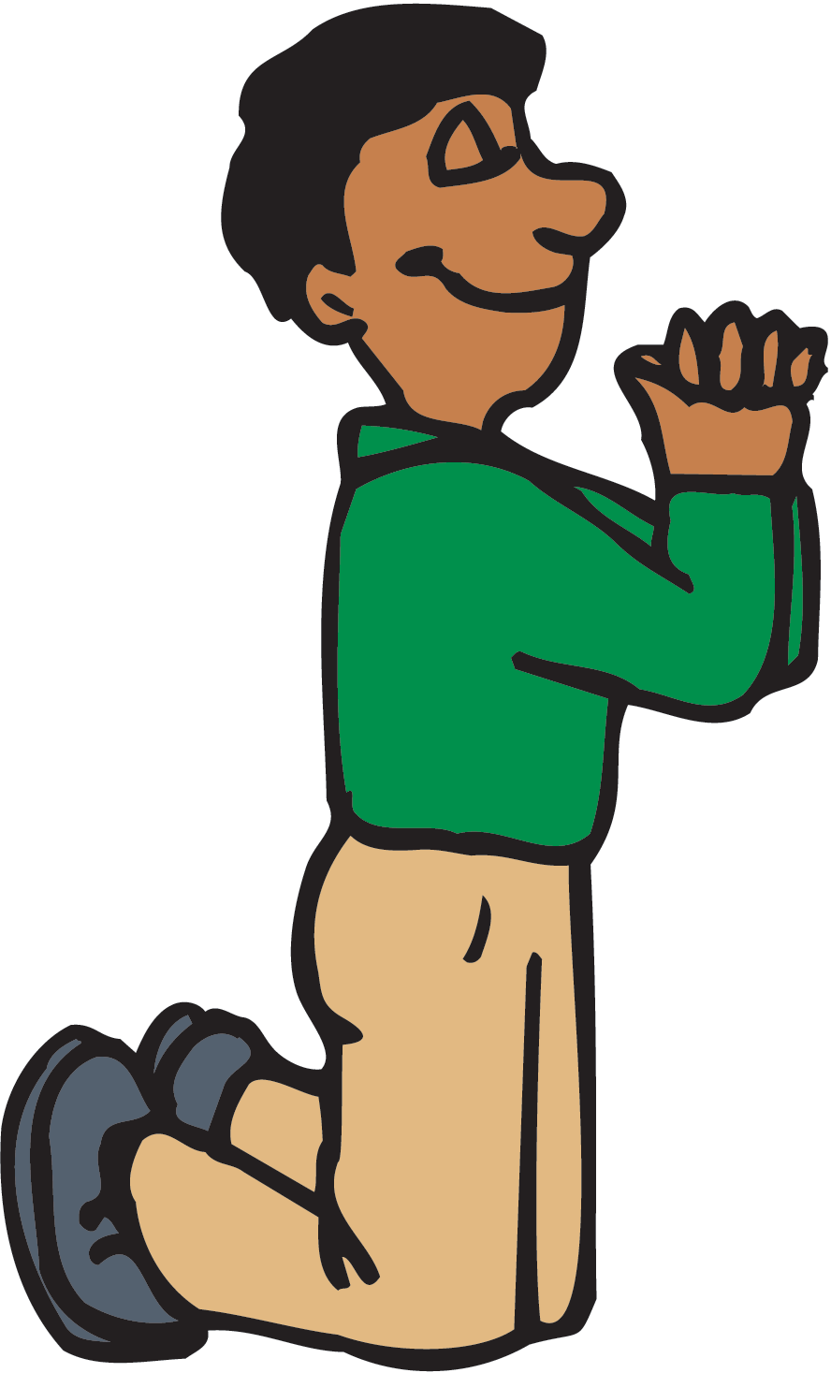

Match to create sentences
Put them in order to create a cool conversation
.
.
I don’t like
And
I have
I don’t have
I like
I see
?
.
.
.
.
A lot/very much
A little
small
Big
I need
But
Notes:
Students combine the picture to create sentences ( to Teach students to be creative in the language and to speak using sentences and string of sentences)

Slide 4

What is the question?
Me pongo y porque

Slide 5
¿what are you wearing in the summer?
? ? ?

