Slide 1
Survival Expressions
生存词句
Shēngcún Cíjù

Slide 2
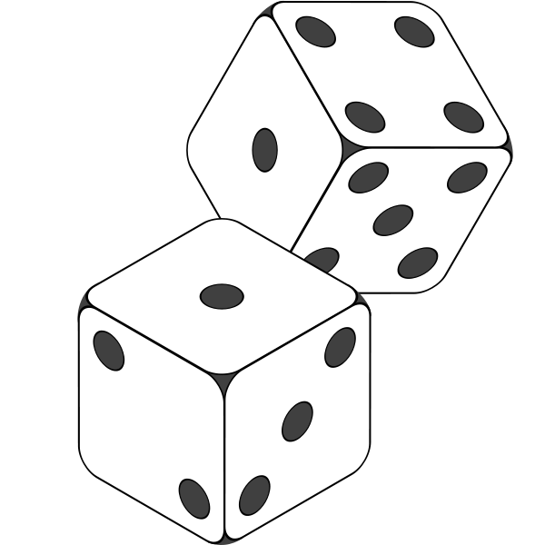
USEFUL EXPRESSIONS FOR GAMES
轮到我 Lún dào wǒ | It is my turn
轮到你 Lún dào nǐ | It is your turn
我需要帮忙Wǒ xūyàobāngmáng | I need help
掷骰子Zhí shǎizi | Roll the dice
这是不对Zhè shì bùduì | It is not correct
这是对Zhè shì duì | It is correct
请,再说一次Qǐng, Zàishuō yīcì | Repeat, please
再来一次Zàiláiyīcì | Try again
清理Qīnglǐ | Clean Up
传出去Chuán chūqù | Pass out
计分Jì fēn | Count the points
我赢了比赛Wǒ yíngle bǐsài | I won the game
我输了比赛Wǒ shūle bǐsài | I lost the game
平手Píngshǒu | It is a tie
没关系Méiguānxì | Doesn’t matter
行Xíng | It is ok/fine
棒Bàng | Excellent

Slide 3
Useful Expressions for Everyday communication
怎么说_____？ | Zěnmeshuō_? | How do you say_______?
这字是什么意思？ | Zhè zì shì shénme yìsi? | What does this word mean?
非常多谢 | Fēicháng duōxiè. | Thank you very much
不客气 | Bù kèqì | You’re welcome
我的荣幸 | Wǒ de róngxìng | My pleasure
请 | Qǐng | Please
原谅我 | Yuánliàng wǒ | Excuse me
对不起 | Duìbùqǐ | I am sorry
没关系 | Méiguānxì | Never mind/Doesn’t matter
传给我 | Chuán gěi wǒ | Pass it to me
请,我需要___。 | Qǐng wǒxūyào_. | I need_____,please.
我有一个问题 | Wǒ yǒu yīgè wèntí | I have a question
我不明白 | Wǒ bù míngbái | I don’t understand
好的 | Hǎo de | All right
当然 | Dāngrán | Of course/sure
我不在乎 | Wǒ bùzàihū | I don’t mind
我不/知道 | Wǒ bù /zhīdào | I don’t know/ I know

